Slide 3

SQL Clinic
Get your SQL questions answered here by our SQL experts during our breaks!
(Across from Registration)

Slide 4

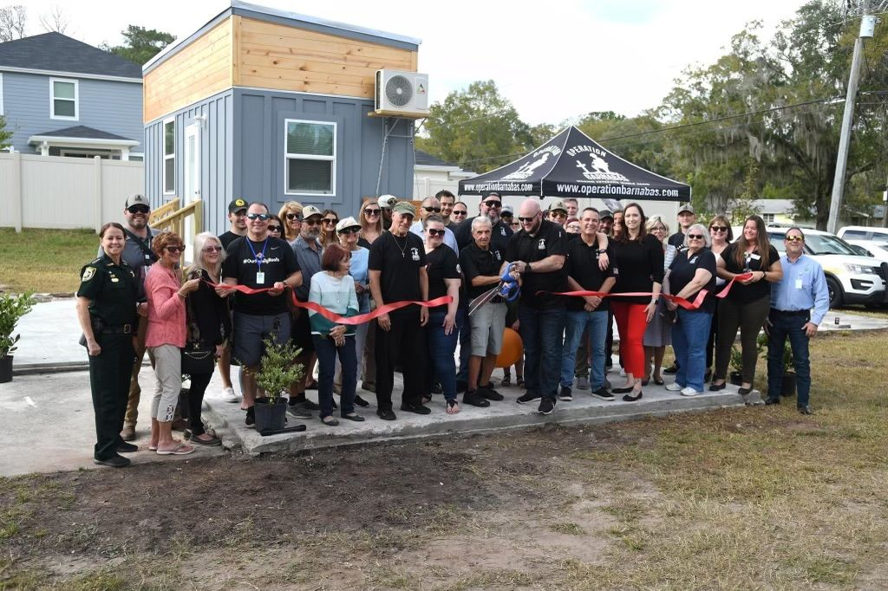
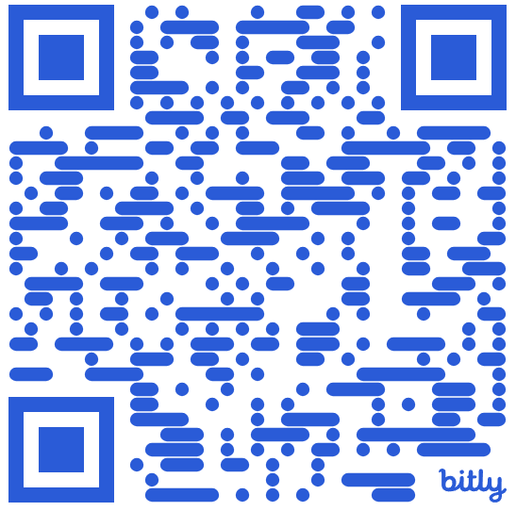
501 Legion Charitable Donation For Housing
Thank the 501 Legion for Supporting Our Event!
JSSUG Will Match Donations up to $500
Donation Bucket on Registration Table
Our vision for Ft. Barnabas is to one day be a bastion of hope and stability in guiding veterans on their path to stability. Fort Barnabas will be constructed as a mixture of portable tiny homes, or “Barnabas Bungalows,” and brick-and-mortar condo-style family homes. https://operationbarnabas.com/get-involved/

Slide 5
Session Evaluations
Your feedback is important to us!
Please fill out and hand to speaker after the session!

Slide 6
Event Evaluation
Fill out event evaluation card in your bag and visit all sponsors to be entered to win an Xbox Series X – (Must be present to win)

Slide 7
Register now!
See you in Seattle!
Get $150 off a 3-day ticket!
Use code: SQLSATJACKS150
passdatacommunitysummit.com

Slide 8
PowerBI for the accidental Data Anlayst
David Seis
DBA/Developer
Straight Path IT Solutions, LLC.

Slide 9
Agenda
Introduction to PowerBI: Learn the basics of PowerBI and how it can be used effectively by those who are new to the tool.
Best Practices: Discover general best practices for using PowerBI, including data modeling, visualization techniques, and report design.
Tips and Tricks: Gain insights into useful tips and tricks that can enhance your PowerBI experience and make your workflow more efficient.

Slide 10
Introduction to PowerBI:
Overview of PowerBI: Understanding what PowerBI is and its core functionalities.
Getting Started: Steps to install and set up PowerBI on your system.
User Interface: Familiarizing yourself with the PowerBI interface and navigation.
Basic Features: Introduction to basic features like data import, visualization, and report creation.
First Project: Creating your first PowerBI project from scratch.

Slide 11
Best Practices:
Data Modeling: Beginner techniques for effective data modeling to ensure accurate analysis.
Visualization Design: Best practices for designing clear and impactful visualizations.
Report Structuring: Structuring reports for easy interpretation and decision-making.
Performance Optimization: Tips for optimizing the performance of your PowerBI reports.

Slide 12
Tips and Tricks:
Shortcut Keys: Useful shortcut keys to speed up your workflow.
Data Transformation: Efficient ways to transform and clean data within PowerBI.
Automation: Automating repetitive tasks to save time and effort.
Star Schema Design should be the rule of thumb.
Work towards a Data Warehouse rather than data marts

Slide 13
PowerBI for the accidental Data Anlayst
David Seis
David.Seis@StraightPathSQL.com
https://www.linkedin.com/in/DavidSeis

